Slide 1
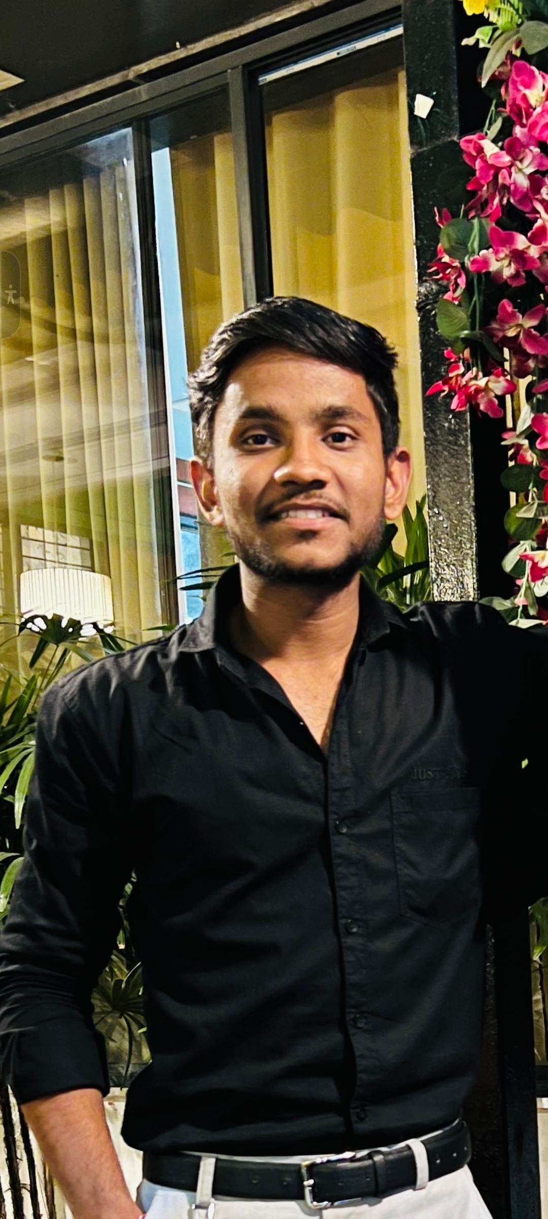
Profile Summary
With 1+ year of experience in development, I am an accomplished backend developer proficient in building robust and scalable web applications. I have a strong understanding of Java programming language and extensive knowledge of the Spring Boot framework. My expertise lies in designing and implementing RESTful and Spring JPA and developing microservices architecture. During my previous engagements, Also integrated various third-party software/APIs and implemented authentication and authorization using Spring Security. I am well-versed in working with databases like MySQL and Oracle, and have solid understanding of SQL queries. My ability to collaborate effectively with cross-functional teams and my strong problem-solving skills enable me to deliver high-quality software solutions. I am committed to continuously improve my skills and contribute towards the success of the organization.
Sanskar Trivedi
Software Engineer
Hinjewadi, Pune
sanskartvd786@gmail.com
Experience
Organization: Persistent Systems
Role: Software Engineer
Time-period: June 2022 - Present
Summary: Grasped Java Spring boot knowledge on live Vertiv project to complete UPS association and Graceful Shutdown functionality for hosts.
Key Responsibilities:
Integrate Hyper-V with application
Perform Graceful shutdown of hosts & Optimize association.
Role: Software Engineer Intern
Time-period: Jan 2022 – June 2022
Summary: Trained on backend technology using Java Spring Boot including SQL and GIT.
Key Responsibilities:
Complete assessment post training
Organization: Sofmen Technologies
Role: Software Developer
Time-period: March 2021 – December 2021
Summary: Worked on MERN stack with PostgreSQL, AWS lambda, SQS, Build a system to process millions of leads to send RVM( Recorded Voice Mails) by integrating it with RVM providers.
Key Responsibilities:
Code optimization to process millions of data.
Communicate and coordinate with clients.
Add new functionality & fix bugs.
Total experience | 1 Year 13 months
Education | Acropolis Institute of Technology and Research Bachelor of Technology Computer Science
Skills | Python Java Spring Boot SQL Javascript
Contact | LinkedIn +91 7389069311
Certifications:
IBM SQL and Relational Databases
AWS Cloud Foundations
Azure Fundamentals AZ-900

